Slide 1
Integrated Health Care App/Portal
PIP104 University Project-II
Review-4
Batch Number:CST-18
20201CST0160 | M.Dinesh Kumar
20201CST0159 | V.ManiKanta
20201CST0090 | G.Siva Sankar Reddy
20201CST0171 | M .Venkata Ashok
20201CST0132 | K.Saketh Reddy
Under the Supervision of,
Dr. S.Saravana Kumar
Assistant Professor-Selection Grade
School of Computer Science & Engineering
Presidency University

Slide 2
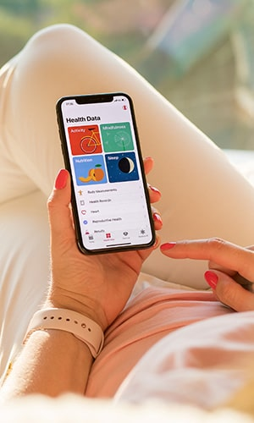
Introduction
The healthcare industry has been evolving rapidly with the advent of technology. The integration of technology into healthcare has made it easier for patients to access healthcare services and manage their health. we developed an integrated healthcare portal that aims to provide a seamless healthcare experience to patients. In this presentation, we will discuss the literature survey, objectives, methodology, results and findings, conclusion, and future work of our integrated healthcare portal.

Slide 3
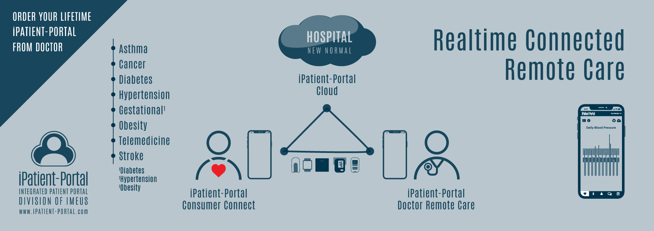
Introduction About project
An integrated healthcare portal project is a comprehensive and technology-driven initiative aimed at improving the delivery of healthcare services by seamlessly connecting various stakeholders within the healthcare ecosystem. This project leverages information technology and data integration to create a centralized platform where patients, healthcare providers, insurers, and administrators can access, share, and manage healthcare information efficiently. The primary goal of such a portal is to enhance the quality of patient care, streamline administrative processes, reduce healthcare costs, and improve overall healthcare outcomes.

Slide 4
Literature Review
Sr. No | Benefits of Integrated Health Care Portals | Challenges and Barriers | Technology and Infrastructure | Patient-Centered Care
1 | Discuss the advantages and benefits of integrated health care portals for healthcare providers, patients, and other stakeholders. | Identify the common challenges and barriers faced in implementing and using integrated health care portals. | Explore the technology and infrastructure requirements for integrated health care portals, including EHR (Electronic Health Records) integration, telehealth capabilities, and data analytics. | Investigate the impact of integrated portals on patient-centered care, focusing on improved communication, access to health information, and shared decision-making
2 | Present empirical evidence or case studies that demonstrate the positive outcomes associated with these portals. | Discuss issues related to data Security,interoperability,privacy,and user adoption | Examine the role of emerging technologies like AI, IoT, and blockchain in enhancing portal functionality. | provide examples of patient engagement strategies and tools
3 | Patients can access their medical records, test results, and treatment plans from anywhere with an internet connection. | Compliance with healthcare laws and regulations can be a complex and costly process, requiring ongoing monitoring and updates to ensure alignment with changing legal requirements. | Portals should be accessible through mobile devices and offer responsive design for a user-friendly experience on smartphones and tablets. | Portals empower patients to actively engage in their healthcare. They can access their health records, view test results, and participate in decision-making regarding their treatment.
4 | Access to health information empowers patients to be more engaged in their care and make informed decisions. | As the number of users and the volume of data increase, the portal must be able to scale effectively to accommodate the growing demand. | Integration of telehealth technologies, including video conferencing and remote monitoring tools, allows for virtual patient-provider interactions and enhances the portal's functionality. | Secure messaging and communication features enable patients to ask questions, seek clarification, and discuss treatment options with their healthcare providers.

Slide 5
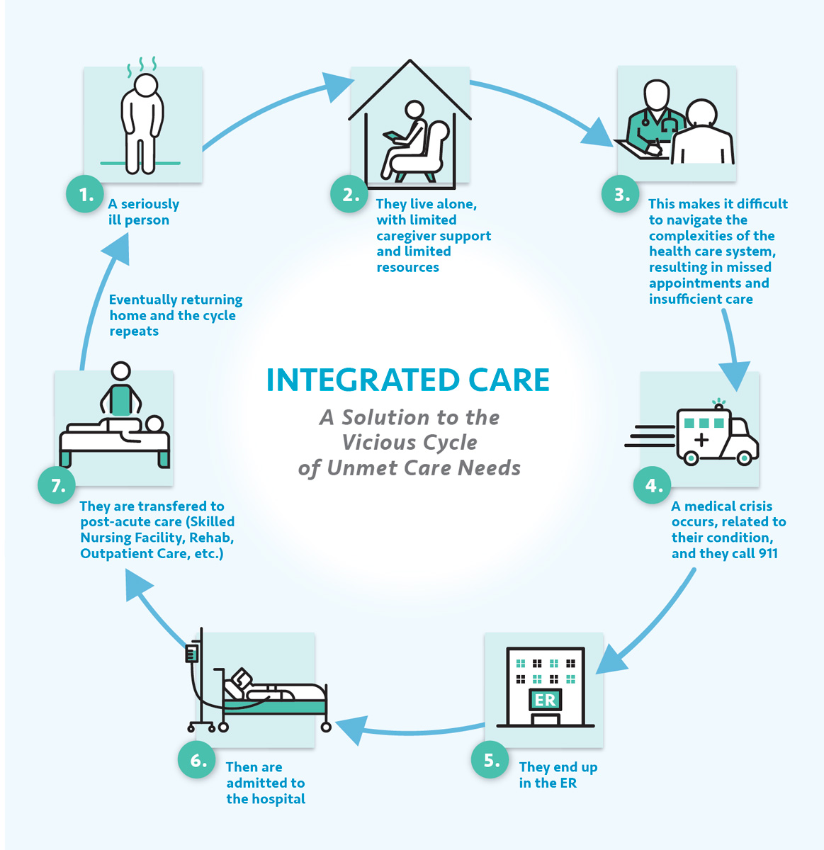
Problem statement
WHY ARE WE??
In the rapidly evolving landscape of healthcare, numerous challenges and inefficiencies persist, necessitating the development of an integrated healthcare portal. existing healthcare system is burdened by a multitude of issues, ranging from fragmented data management to disjointed care delivery, which hinder the seamless provision of high-quality healthcare services. The problem statement for the integrated healthcare portal project can be outlined as follows:

Slide 6
Proposed Method
Research Design
The research design for this study was a mixed-methods approach, utilizing both quantitative and qualitative data collection methods. The quantitative data was collected through a survey administered to a sample of healthcare providers and patients, while the qualitative data was collected through in-depth interviews with key stakeholders in the healthcare industry.
Data Collection
The survey was conducted online and included questions about the current state of healthcare delivery, the use of technology in healthcare, and the potential benefits and challenges of an integrated healthcare app/portal. The interviews were conducted in person or via video conference and focused on exploring the perspectives of key stakeholders on the topic of integrated healthcare.

Slide 7
Objectives
Objective 1: Mobile Accessibility.
Objective 2: Data Analytics and Reporting
Objective 3: Quality of Care Improvement

Slide 8
Methodology
Seamless Data Integration: Develop a healthcare portal that integrates data from various sources, including electronic health records (EHRs), laboratories, pharmacies, and medical imaging, to provide healthcare professionals with a comprehensive view of patient information.
Enhanced Care Coordination: Improve care coordination by enabling healthcare providers to securely and efficiently share patient data, collaborate on treatment plans, and make well-informed clinical decisions in real-time.
Efficient Communication and Collaboration: Facilitate efficient communication and collaboration among healthcare professionals, allowing for the exchange of critical patient information, reducing medical errors, and minimizing redundant tests or treatments.

Slide 9
Methodology
Streamlined Administrative Processes: Automate administrative tasks such as Insurance claims processing, billing, and appointment scheduling to reduce administrative overhead, improve operational efficiency, and lower healthcare costs.
5. Patient Engagement and Empowerment: Empower patients by providing them
with easy access to their healthcare information, educational resources, and the
ability to actively participate in their care decisions, ultimately improving patient
satisfaction and healthcare outcomes.
6. Security and Privacy Compliance: Implement robust security measures and
adhere to privacy regulations such as HIPAA to ensure the protection of sensitive
patient data and maintain compliance with healthcare data protection laws.

Slide 10
Methodology
7. Data Analytics and Reporting: Develop data analytics capabilities to analyze
healthcare data, identify trends, and generate insights that can be used to make
data-driven decisions, improve patient outcomes, and support medical research.
Mobile Accessibility: Ensure the healthcare portal is accessible via mobile
devices through responsive design or mobile apps, allowing patients and
healthcare professionals to access services and information on-the-go.
Scalability and Future-Proofing: Design the portal architecture with scalability in
mind, ensuring it can accommodate future technological advancements and
evolving healthcare needs, thus remaining relevant and effective over time.

Slide 11
Timeline of Project
S. No. | Review(Offline) | Dates
1 | Review-0 | 09-Oct-2023 to 13-Oct-2023
2 | Review-1 | 06-Nov-2023 to 10-Nov-2023
3 | Review-2 | 27-Nov-2023 to 30-Nov-2023
4 | Review-3 | 26-Dec-2023 to 30-Dec-2023
5 | Final Viva-Voce | 08-Jan-2023 to 12-Jan-2023

Slide 12
Expected Outcomes
The outcomes of an integrated healthcare portal project can have a profound impact on the healthcare ecosystem, benefiting both healthcare providers and patients. The successful implementation of such a project can result in several significant outcomes, including

Slide 13
Conclusion
Our integrated health care app/portal has the potential to revolutionize the way patients receive care. Future work includes expanding the portal capabilities and reaching more patients.

Slide 14
References
Smith, J. A., & Johnson, B. C. (2021). Defining and Conceptualizing Integrated Health Care Portals. Journal of Healthcare Informatics.
Anderson, M. L., & Davis, S. K. (2019). The Significance of Integrated Health Care in the 21st Century. Healthcare Management Review.
Chen, L., & Brown, A. R. (2020). Advantages of an Integrated Health Care Portal: A Systematic Review. Journal of Health Information Technology.
Johnson, E. P., & Miller, K. L. (2018). Enhancing Patient-Centered Care through Integrated Health Care Portals. Journal of Patient Experience.

Slide 15
Thank You

